Slide 1

Outland Adventures

Slide 2

Group 2 Team Members
Ryan Church
Darius Dinkins
Taylor Donlea
Tanner Glaser

Slide 3
Case Study Overview
Outland Adventures is a travel outfitter that offers hiking and camping expeditions to several locations around the world.
Each trip is coordinated by a guide who assists clients in planning the travel, as well as vetting visa and immunization requirements. Each location will offer several trips throughout the year led by one of the guides
In addition to the expeditions, the company also offers rental and /or purchase of outdoors equipment and supplies

Slide 4
Optimization Questions
Are there enough customer purchases to continue offering equipment sales?
Are there any inventory items near or over five years old?
Are any of the three trip destinations experiencing a net decrease in bookings?

Slide 5
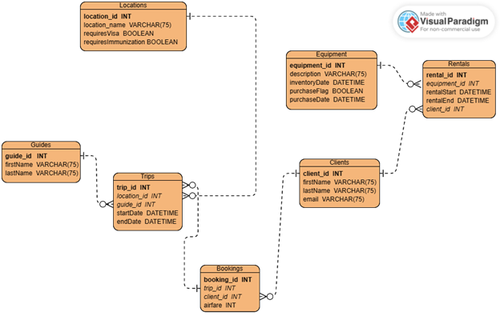
Final ERD Model

Slide 6
Table Details
Guides—list of guides available for a trip
Clients—personal info for clients who can book trips/rent equipment
Trips—instances of a trip to a given location
Bookings—list of clients associated with a given trip
Locations—potential travel destinations
Equipment—List of items available for rental or purchase, along with inventory date for when it came into inventory.
Rentals—Tracks client rentals of equipment

Slide 7
Assumptions
Assumed current list of two guides is the current list of available guides
Assumed airfare costs are dependent on client’s location, so it was moved to the bookings table.
Having an inventory date for when the item was first available will aid in tracking age
A purchase flag/date makes it easy to track what has been purchased.
Assumed clients would book one or more trips

Slide 8

Reports
Car
Ride Share
Taxi
Rental
Air
Int.
Domestic
Rail
Railway

Slide 9
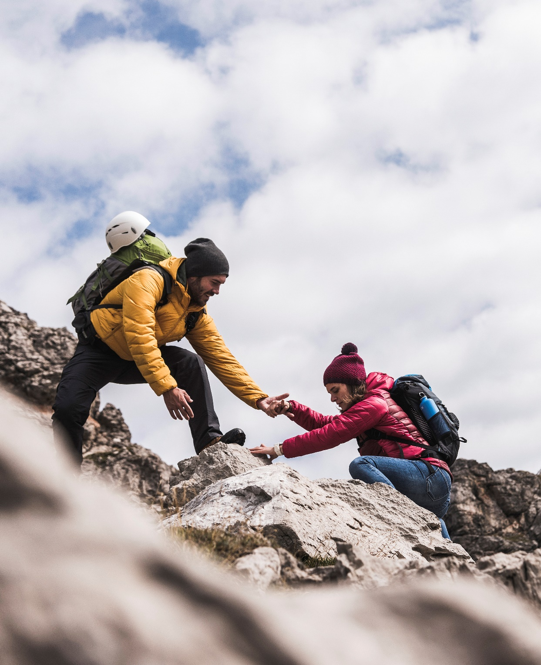
Thank You

